Slide 1
OOPs IN JAVA & FILE HANDLING IN JAVA
BY : Suchithra R

Slide 2
Object Oriented Programming (OOPs) Concept in Java
As the name suggests, Object-Oriented Programming or OOPs refers to languages that use objects in programming, they use objects as a primary source to implement what is to happen in the code.
Objects are seen by the viewer or user, performing tasks assigned by you. Object-oriented programming aims to implement real-world entities like inheritance, hiding, polymorphism etc.
The main aim of OOP is to bind together the data and the functions that operate on them so that no other part of the code can access this data except that function.

Slide 3
Access Modifier: Defines the access type of the method i.e. from where it can be accessed in your application. In Java, there are 4 types of access specifiers:
public: Accessible in all classes in your application.
protected: Accessible within the package in which it is defined and in its subclass(es) (including subclasses declared outside the package).
private: Accessible only within the class in which it is defined.
default (declared/defined without using any modifier): Accessible within the same class and package within which its class is defined.

Slide 4
Message Passing:
Objects communicate with one another by sending and receiving information to each other.
A message for an object is a request for execution of a procedure and therefore will invoke a function in the receiving object that generates the desired results.
Message passing involves specifying the name of the object, the name of the function and the information to be sent.

Slide 5
The return type: The data type of the value returned by the method or void if it does not return a value.
Method Name: The rules for field names apply to method names as well, but the convention is a little different.
Parameter list: Comma-separated list of the input parameters that are defined, preceded by their data type, within the enclosed parentheses. If there are no parameters, you must use empty parentheses ().
Exception list: The exceptions you expect the method to throw. You can specify these exception(s).
Method body: It is the block of code, enclosed between braces, that you need to execute to perform your intended operations

Slide 6
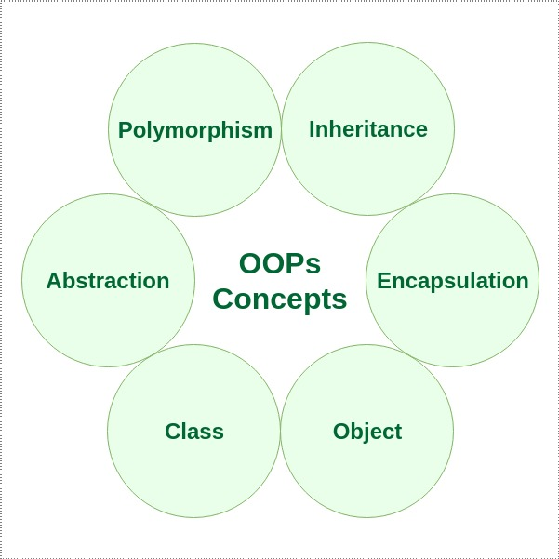
OOPs Concepts

Slide 7
CLASS
A class is a user-defined blueprint or prototype from which objects are created. It represents the set of properties or methods that are common to all objects of one type.
Modifiers
Class name
Superclass
Interfaces
Body

Slide 8
OBJECT
An object is a basic unit of Object-Oriented Programming that represents real-life entities. A typical Java program creates many objects, which as you know, interact by invoking methods.
The objects are what perform your code, they are the part of your code visible to the viewer/user. An object mainly consists of:
State
Behavior
Identity

Slide 9
Class and object in java program
public class GFG {
static String Employee_name;
static float Employee_salary;
static void set(String n, float p) {
Employee_name = n;
Employee_salary = p;
}
static void get() {
System.out.println("Employee name is: " +Employee_name );
System.out.println("Employee CTC is: " + Employee_salary);
}
public static void main(String args[]) {
GFG.set("Rathod Avinash", 10000.0f);
GFG.get();
}
}

Slide 10
ABSTRACTION
Data Abstraction may also be defined as the process of identifying only the required characteristics of an object, ignoring the irrelevant details.
//abstract class abstract class GFG{ //abstract methods declaration abstract void add(); abstract void mul(); abstract void div(); }

Slide 11
ENCAPSULATION
Encapsulation can be achieved by declaring all the variables in a class as private and writing public methods in the class to set and get the values of the variables.
//Encapsulation using private modifier //Employee class contains private data called employee id and employee name class Employee { private int empid; private String ename; }

Slide 12
INHERITANCE
Inheritance is an important pillar of OOP (Object Oriented Programming). It is the mechanism in Java by which one class is allowed to inherit the features (fields and methods) of another class.
//base class or parent class or super class class A{ //parent class methods void method1(){} void method2(){} } //derived class or child class or base class class B extends A{ //Inherits parent class methods //child class methods void method3(){} void method4(){} }

Slide 13
POLYMORPHISM
Refers to the ability of object-oriented programming languages to differentiate between entities with the same name efficiently. This is done by Java with the help of the signature and declaration of these entities. The ability to appear in many forms is called polymorphism.
sleep(1000) //millis
sleep(1000,2000) //millis,nanos

Slide 14
Why file handling is required?
File Handling is an integral part of any programming language as file handling enables us to store the output of any particular program in a file and allows us to perform certain operations on it.
In simple words, file handling means reading and writing data to a file.
// Importing File Class import java.io.File; class GFG { public static void main(String[] args) { // File name specified File obj = new File("myfile.txt"); System.out.println("File Created!"); } }

Slide 15
Streams of java
In Java, a sequence of data is known as a stream.
This concept is used to perform I/O operations on a file.
There are two types of streams :
1.Input stream
2.Output stream

Slide 16
INPUT STREAM
The Java InputStream class is the superclass of all input streams. The input stream is used to read data from numerous input devices like the keyboard, network, etc.
There are several subclasses of the InputStream class, which are as follows:
AudioInputStream
ByteArrayInputStream
FileInputStream
FilterInputStream
StringBufferInputStream
ObjectInputStream

Slide 17
Methods of input stream
S No. | Method | Description
1 | read() | Reads one byte of data from the input stream.
2 | read(byte[] array)() | Reads byte from the stream and stores that byte in the specified array.
3 | mark() | It marks the position in the input stream until the data has been read.
4 | available() | Returns the number of bytes available in the input stream.
5 | markSupported() | It checks if the mark() method and the reset() method is supported in the stream.
6 | reset() | Returns the control to the point where the mark was set inside the stream.
7 | skips() | Skips and removes a particular number of bytes from the input stream.
8 | close() | Closes the input stream.

Slide 18
OUTPUT STREAM
The output stream is used to write data to numerous output devices like the monitor, file, etc. OutputStream is an abstract superclass that represents an output stream.
There are several subclasses of the OutputStream class which are as follows:
ByteArrayOutputStream
FileOutputStream
StringBufferOutputStream
ObjectOutputStream
DataOutputStream
PrintStream

Slide 19
Methods of output stream
S. No. | Method | Description
1. | write() | Writes the specified byte to the output stream.
2. | write(byte[] array) | Writes the bytes which are inside a specific array to the output stream.
3. | close() | Closes the output stream.
4. | flush() | Forces to write all the data present in an output stream to the destination.

Slide 20
Based on the data type, there are two types of streams :
1. Byte Stream:
This stream is used to read or write byte data. The byte stream is again subdivided into two types which are as follows:
Byte Input Stream:
Used to read byte data from different devices.
Byte Output Stream:
Used to write byte data to different devices.
2. Character Stream:
This stream is used to read or write character data. Character stream is again subdivided into 2 types which are as follows:
Character Input Stream:
Used to read character data from different devices.
Character Output Stream:
Used to write character data to different devices.

Slide 21
Java File Class Methods
Method Name | Description | Return Type
canRead() | It tests whether the file is readable or not. | Boolean
canWrite() | It tests whether the file is writable or not. | Boolean
createNewFile() | It creates an empty file. | Boolean
delete() | It deletes a file. | Boolean
exists() | It tests whether the file exists or not. | Boolean
length() | Returns the size of the file in bytes. | Long
getName() | Returns the name of the file. | String
list() | Returns an array of the files in the directory. | String[]
mkdir() | Creates a new directory. | Boolean
getAbsolutePath() | Returns the absolute pathname of the file. | String

Slide 22
Files operations in java
The following are the several operations that can be performed on a file in Java :
1.Create a File
2.Read from a File
3.Write to a File
4.Delete a File
Now let us study each of the above operations in detail.

Slide 23
1.Create a file
I
// Import the File class import java.io.File; // Import the IOException class to handle errors import java.io.IOException; public class GFG { public static void main(String[] args) { try { File Obj = new File("myfile.txt"); if (Obj.createNewFile()) { System.out.println("File created: " + Obj.getName()); } else { System.out.println("File already exists."); } } catch (IOException e) { System.out.println("An error has occurred."); e.printStackTrace(); } } }

Slide 24
2.Read from a file
// Import the File class import java.io.File; // Import this class for handling errors import java.io.FileNotFoundException; // Import the Scanner class to read content from text files import java.util.Scanner; public class GFG { public static void main(String[] args) { try { File Obj = new File("myfile.txt"); Scanner Reader = new Scanner(Obj); while (Reader.hasNextLine()) { String data = Reader.nextLine(); System.out.println(data); } Reader.close(); } catch (FileNotFoundException e) { System.out.println("An error has occurred."); e.printStackTrace(); } } }

Slide 25
3.Write to a file
// Import the FileWriter class import java.io.FileWriter; // Import the IOException class for handling errors import java.io.IOException; public class GFG { public static void main(String[] args) { try { FileWriter Writer = new FileWriter("myfile.txt"); Writer.write( "Files in Java are seriously good!!"); Writer.close(); System.out.println("Successfully written."); } catch (IOException e) { System.out.println("An error has occurred."); e.printStackTrace(); } } }

Slide 26
4.Delete a file
// Import the File class import java.io.File; public class GFG { public static void main(String[] args) { File Obj = new File("myfile.txt"); if (Obj.delete()) { System.out.println("The deleted file is : " + Obj.getName()); } else { System.out.println( "Failed in deleting the file."); } } }

Slide 27
THANK YOU

